Slide 1
Hierarchical Agglomerative Clustering
Chien Chin Chen

Slide 2
Preface
Different to flat clustering, hierarchical clustering outputs a hierarchy.
A structure (tree) that is supposed to be more informative than the unstructured set of clusters in flat clustering.
Some researchers believe that hierarchical clustering produces better clusters than flat clustering But … there is no consensus on this issue.
This chapter focuses on hierarchical agglomerative clustering (HAC).
Present five different linkage measures: single-link, complete-link, group-average, centroid similarity, and Ward.
Clustering result is deterministic!!

Slide 3
Hierarchical Agglomerative Clustering (1/6)
A bottom-up approach.
Treats each document as a singleton cluster at the outset.
Successively merge (or agglomerate) pairs of clusters until all clusters have been merged into a single cluster.
An HAC clustering is typically visualized as a dendrogram.

Slide 4
Hierarchical Agglomerative Clustering (2/6)
A merge of two clusters is represented as a horizontal line.
The y-axis represents combination similarity (or distance).
The similarity of the two clusters connected by the horizontal line.
The y-axis at leaf nodes is 1.
To represent each cluster as a document.

Slide 5
Hierarchical Agglomerative Clustering (3/6)
SimpleHAC (d₁, ..., d_{N})
for n ← 1 to N
do for i ← 1 to N
do C[n][i] ← Sim(d_{n},d_{i})
I[n] ← 1
A ← []
for k ← 1 to N-1
do <i,m> ← argmax{<i,m>: i≠m and I[i]=1 and I[m]=1}C[i][m]
A.Append(<i,m>)
for j ← 1 to N
do C[i][j] ← Sim(j,i,m)
C[j][i] ← Sim(j,i,m)
I[m] ← 0
return A
C[i][j]: the similarity between
clusters i and j.
I: indicate which clusters are
still available to be merged.
A: a list of merges
the similarity of cluster j with
the merge of cluster i and m.

Slide 6
Hierarchical Agglomerative Clustering (4/6)
C
1
2
3
9
1
2
I =
I[1] | I[2] | I[3] | I[4] | I[5] | I[6] | I[7] | I[8] | I[9] | I[10]
1 | 1 | 1 | 1 | 1 | 1 | 1 | 1 | 1 | 1
3
0
…
0
A = { }
<3,9>
<1,2>
9
…
1. Search for the max similarity pair - <i,m>
1
2. Record and merge cluster m into cluster i.
3
Update the pair similarities between
the new merged cluster i. and other clusters.
1
2
3
4
5
6
7
8
9
10
I[m] = 0, remove the merged cluster m.
So complicated …
No worry, SKLearn helps us do it in an easy way!!

Slide 7
Hierarchical Agglomerative Clustering (5/6)
In some cases, we want a partition of disjoint clusters just as in flat clustering.
The hierarchy needs to be cut at some point!!
Criteria of cutting:
As in flat clustering, we can also pre-specify the number of clusters K.
Cut at a pre-specified level of similarity.
We cut the dendrogram at 0.4.
We want clusters with a minimum combination similarity of 0.4.
Cut the dendrogram where the gap between two successive combination similarities is largest.
Merging one more cluster decreases the quality of the clustering significantly.

Slide 8
Hierarchical Agglomerative Clustering (6/6)
Cutting at 0.1
yields 12 clusters.
Cutting at 0.4
yields 24 clusters.

Slide 9
Single-link and Complete-link (1/7)
Single-link :
The similarity of two clusters is the similarity of their most similar members.
This merge criterion is local.
We pay attention solely to the area where the two clusters come closest to each other.
The cluster overall structure is not taken into account.

Slide 10
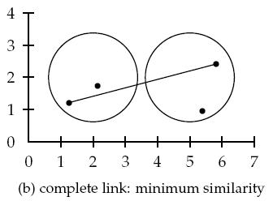
Single-link and Complete-link (2/7)
Complete-link :
The similarity of two cluster is the similarity of their most dissimilar members.
This merge criterion is non-local.
The entire structure of the clustering can influence merge decision.
Is equivalent to choosing the cluster pair whose merge has the smallest diameter.

Slide 11
Single-link and Complete-link (3/7)
Single-link
Complete-link
4
4
3
3
2
2
1
1
1
2
3
4
1
2
3
4

Slide 12
Single-link and Complete-link (4/7)
Graph-theoretic interpretations:
Let s_{k} to be the combination similarity of the two clusters merged in step k.
G(s_{k}) the graph that links all data points with a similarity of at least s_{k}.
Then, the clusters after step k in single-link clustering are the connected components of G(s_{k}).
Points in a clusters are linked via at least one link → single-link!!
And the clusters after step k in complete-link clustering are maximal cliques of G(s_{k}).
A clique is a set of points that are completely linked with each other → complete-link!!

Slide 13
Single-link and Complete-link (5/7)
Single-link assesses cluster quality via a pair of document.
The two most similar documents.
Clustering based on one pair cannot fully reflect the distribution of documents in a cluster.
Chaining: a problem of single-link.
A chain of points can be extended for long distances without regard to the overall shape of the cluster.

Slide 14
Single-link and Complete-link (6/7)
The last 12 merges add on
single documents → chaining!!
We often prefer compact clusters with
small diameters over long, straggly clusters.

Slide 15
Single-link and Complete-link (7/7)
The problem of complete-link clustering – very sensitive to outliers.
A single document far from the center can increase diameters of candidate merge clusters dramatically.

Slide 16
Group-average Linkage (1/2)
Group-average:
The similarity of two cluster is the average similarity of all pairs of documents.
Including pairs from the same cluster!!
But self-similarities are not included in the average!!
clusters i and j
the number of
documents in
cluster i
the normalized
document vectors

Slide 17
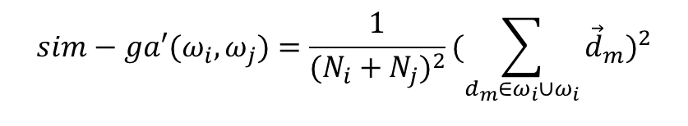
Group-average Linkage (2/2)
Why not including self-similarity?
If we define group-average similarity as including self-similarities:
For a cluster of size i, the proportion of self-similarities is i/i² or 1/i.
This gives an unfair advantage to small clusters.
Moreover, for two documents d₁, d₂ with similarity s
sim-ga’(d₁,d₂) = (2+2s)/4 = (1+s)/2.
sim-ga(d₁,d₂) = 2s/2 = s.
is the same as in single-link, complete-link, and centroid clustering.
$$sim−ga′(ω_{i},ω_{j})=\frac{1}{(N_{i}+N_{j})^{2}}(\sum_{d_{m}∈ω_{i}∪ω_{i}}{{\vec{d}}_{m}})^{2}$$

Slide 18

Centroid Linkage
Centroid linkage:
The similarity of two cluster is defined as the similarity of their centroids:
The similarity is equivalent to average similarity of all pairs of documents from different clusters.
$$sim−cent(ω_{i},ω_{j})=(\frac{1}{N_{i}}\sum_{d_{m}∈ω_{i}}{{\vec{d}}_{m}})⋅(\frac{1}{N_{j}}\sum_{d_{n}∈ω_{j}}{{\vec{d}}_{n}}) \\ =\frac{1}{N_{i}N_{j}}\sum_{d_{m}∈ω_{i}}{\sum_{d_{n}∈ω_{j}}{{\vec{d}}_{m}⋅{\vec{d}}_{n}}}$$

Slide 19
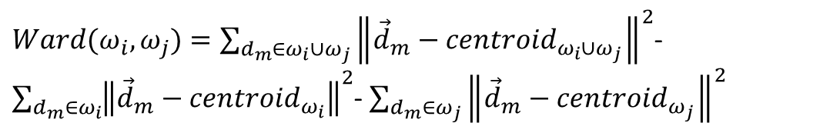
Ward’s Linkage (1/2)
Ward’s Linkage:
The distance between two clusters is how much the sum of squares will increase when we merge them:
The sum of squares starts out at zero, and grows as we merge clusters
In the beginning, every document (vector) is in its own cluster.
Ward’s linkage keeps this growth as small as possible.
$Ward(ω_{i},ω_{j})=\sum_{d_{m}∈ω_{i}{∪ω}_{j}}{{\left\|{\vec{d}}_{m}−{centroid}_{ω_{i}{∪ω}_{j}}\right\|}^{2}}$- $\sum_{d_{m}∈ω_{i}}{{\left\|{\vec{d}}_{m}−{centroid}_{ω_{i}}\right\|}^{2}}$- $\sum_{d_{m}∈ω_{j}}{{\left\|{\vec{d}}_{m}−{centroid}_{ω_{j}}\right\|}^{2}}$

Slide 20
Ward’s Linkage (2/2)
Which two clusters would
Ward’s linkage group first?
Another interpretation of Ward’s linkage is to minimize the variance of the clusters being merged.

Slide 21
Which Similarity Strategy Is The Best ?
[Voorhees 1985] recommends complete-link and centroid clustering over single-link for a retrieval application.
But in news-related applications (e.g., event/topic detection), single-link seems to be a better strategy.
Allan et al. (1998) apply the single-link clustering to first story detection.

Slide 22
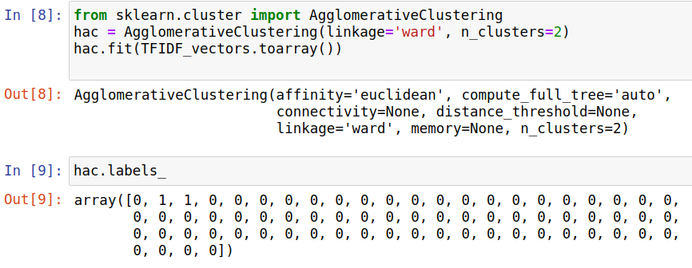
Practice Time (1/2)
Parameters:
linkage: ward, single, complete, average
default – ward
n_clusters: the number of clusters to find.
distance_threshold: the distance threshold to stop merging

Slide 23
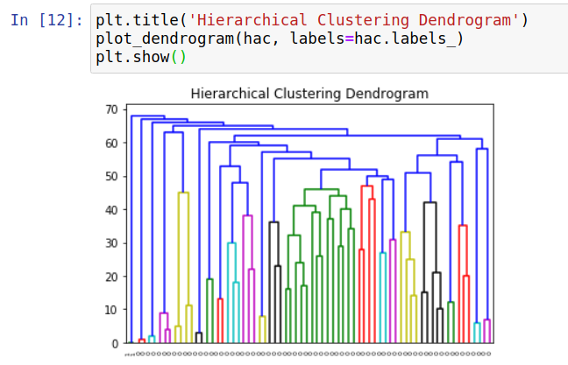
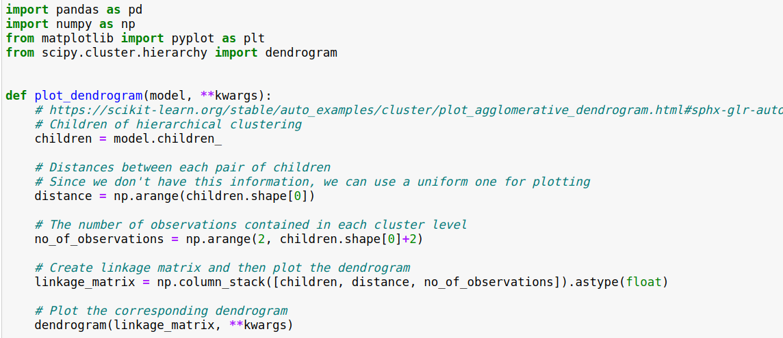
Practice Time (2/2)
How to show the cluster hierarchy?

